Slide 1

Easter Service

Slide 2
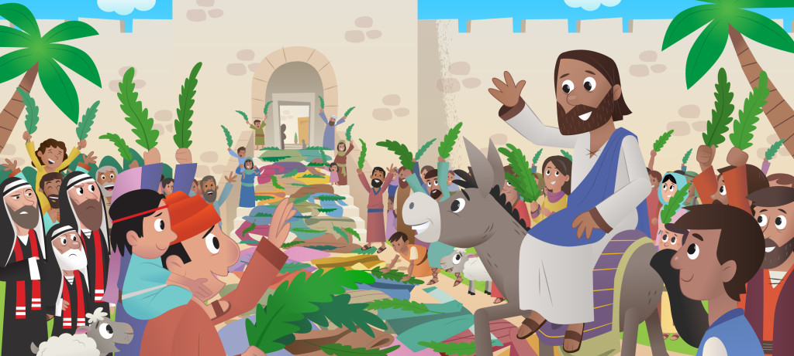

Slide 3
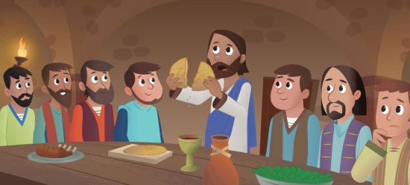

Slide 4
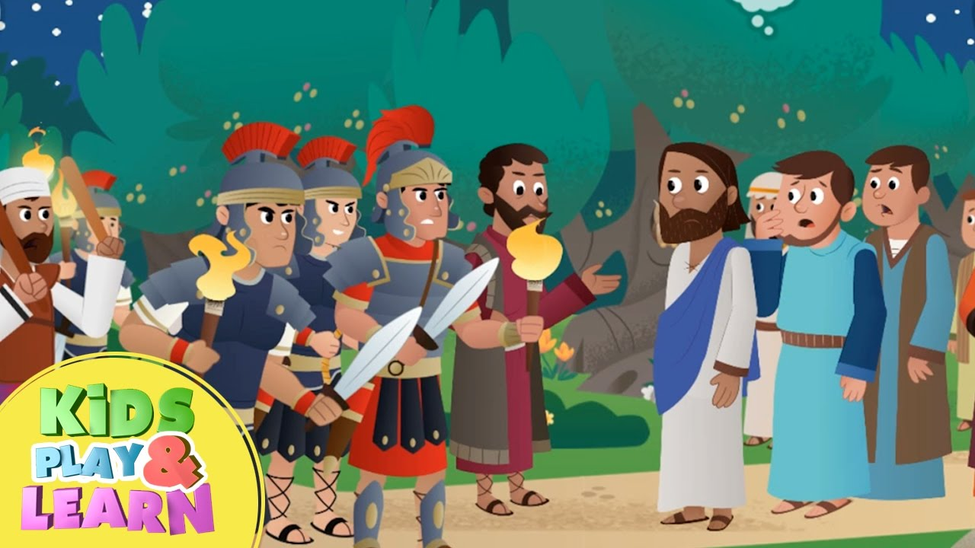

Slide 5
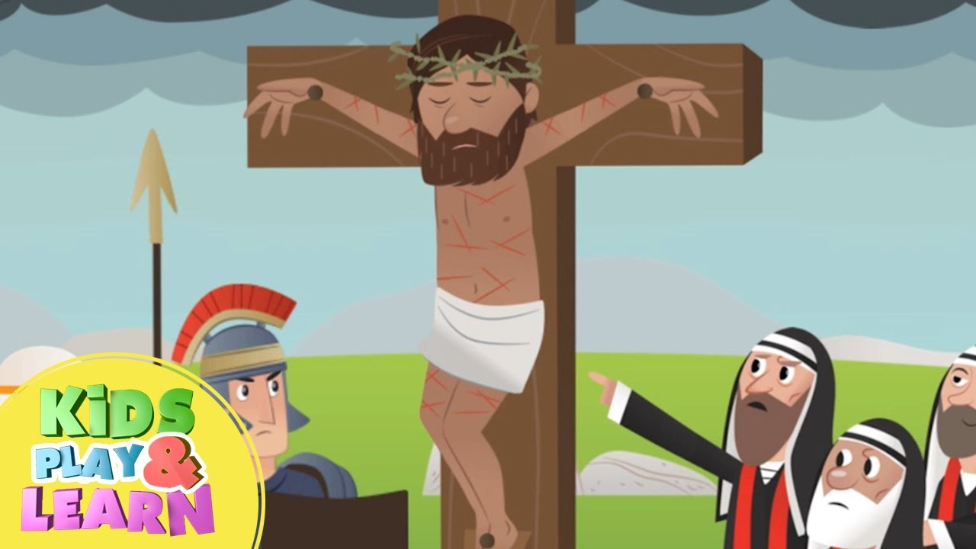

Slide 6


Slide 7

Easter Story
Falsely accused, but He made no reply,
Did nothing wrong but was sentenced to die,
Was mocked by the soldiers and jeered by the crowd,
And nailed to a cross.
Three hours of darkness fell over the land,
Jesus cried out, ‘It is finished’, then died.
They pierced His side, took Him down from the cross,
And laid Him in a tomb.
Into Jerusalem Jesus arrived,
Humbly He chose just a donkey to ride,
The people laid branches and cloaks on the ground
To welcome in their King.
Only days later how everything changed,
After He shared a last meal with His friends,
Now soldiers arrested Him, He was betrayed,
Completely on His own.
They came to the tomb, found the stone rolled away,
Angels now stood where His body had lain,
‘Do not be afraid because He is not here,
He’s risen from the dead!’
Chorus (with harmonies)
Hallelujah, hallelujah, hallelujah, hallelujah,
Hallelujah, hallelujah, hallelujah, hallelujah.
Chorus He came to earth for us,
He gave His life in love,
He did it for you and for me.
And now he is alive,
He’s risen from the dead,
The name far above every name.
Hallelujah, hallelujah,
Hallelujah, hallelujah.

Slide 8

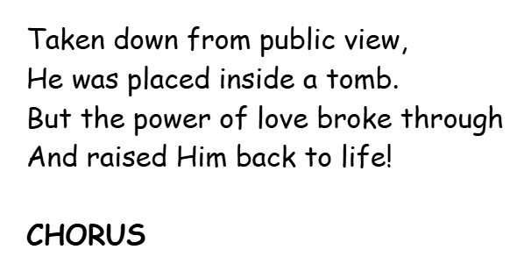
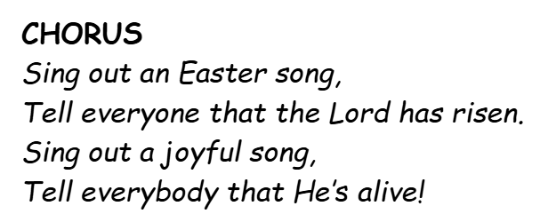
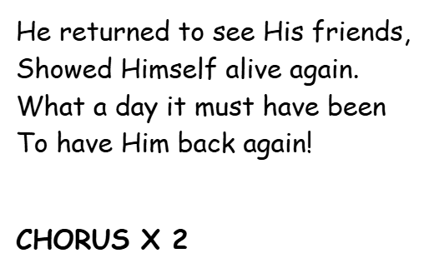
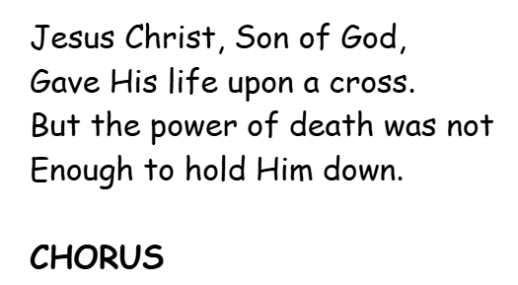
EASTER SONG

Slide 9

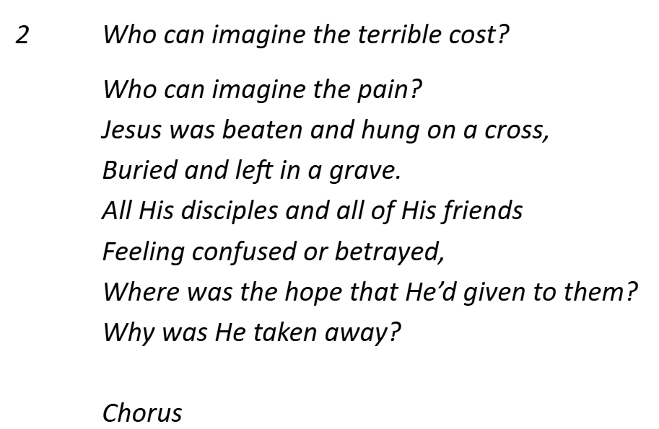
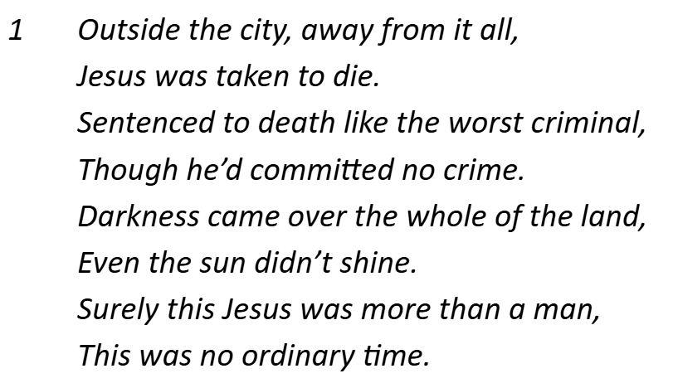
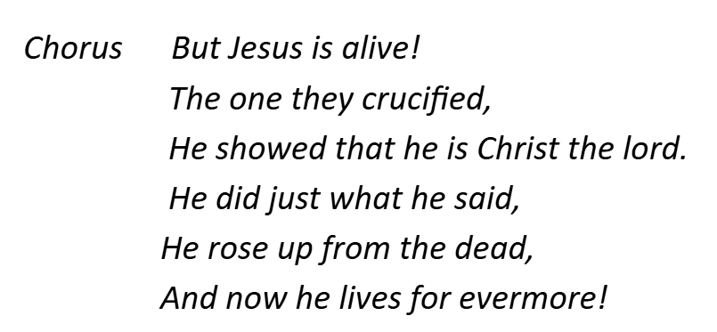
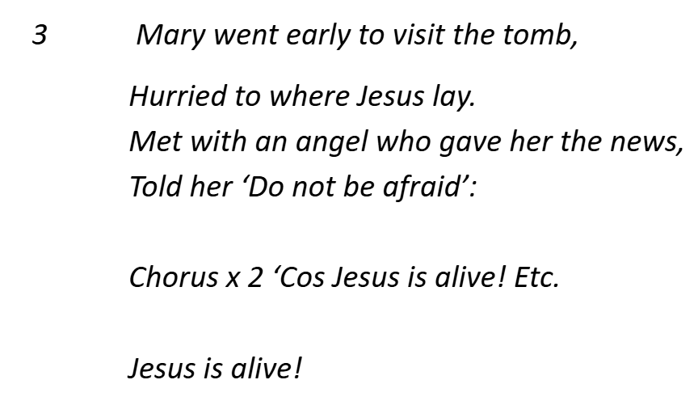
Jesus is alive!

Slide 10
